Slide 1
Competing with
Information Technology
2

Slide 2
Objectives
2
Identify basic competitive strategies and explain how IT may be used to gain competitive advantage.
Identify strategic uses of information technology.
How does business process engineering frequently use e-business technologies for strategic purposes?

Slide 3
(Objectives – continued)
2
Identify the business value of using e-business technologies for total quality management, to become an agile competitor, or to form a virtual company.
Explain how knowledge management systems can help a business gain strategic advantage.

Slide 4
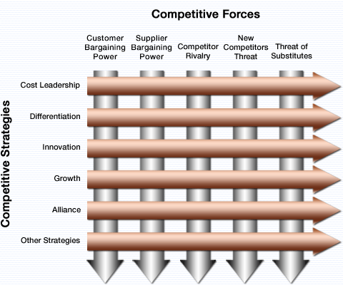
Fundamentals of Strategic Advantage
2

Slide 5
Fundamentals of Strategic Advantage
2
Competitive Forces (Porter)
  Bargaining power of customers
  Bargaining power of suppliers
  Rivalry of competitors
  Threat of new entrants
  Threat of substitutes

Slide 6
Competitive Strategies & the Role of IT
2
Cost Leadership (low cost producer)
  Reduce inventory (JIT)
  Reduce manpower costs per sale (see Real World Case 1)
  Help suppliers or customers reduce costs
  Increase costs of competitors
  Reduce manufacturing costs (process control)

Slide 7
Competitive Strategies & the Role of IT
(continued)
2
Differentiation
  Create a positive difference between your products/services & the competition.
  May allow you to reduce a competitor’s differentiation advantage.
  May allow you to serve a niche market.

Slide 8
Competitive Strategies & the Role of IT
(continued)
2
Innovation
  New ways of doing business
    Unique products or services
    New ways to better serve customers
    Reduce time to market
    New distribution models

Slide 9
Competitive Strategies & the Role of IT
(continued)
2
Growth
  Expand production capacity
  Expand into global markets
  Diversify
  Integrate into related products and services.

Slide 10
Competitive Strategies & the Role of IT
(continued)
2
Alliance
  Broaden your base of support
    New linkages
  Mergers, acquisitions, joint ventures, “virtual companies”
  Marketing, manufacturing, or distribution agreements.

Slide 11
Competitive Strategies & the Role of IT
(continued)
2
Other Competitive Strategies
  Locking in customers or suppliers
    Build value into your relationship
  Creating switching costs
    Extranets
    Proprietary software applications

Slide 12
Competitive Strategies & the Role of IT
(continued)
2
Other Competitive Strategies (continued)
  Raising barriers to entry
    Improve operations or promote innovation
  Leveraging investment in IT
    Allows the business to take advantage of strategic opportunities

Slide 13
The Value Chain
2
Views a firm as a series, chain, or network of activities that add value to its products and services.
  Improved administrative coordination
  Training
  Joint design of products and processes
  Improved procurement processes
  JIT inventory
  Order processing systems

Slide 14
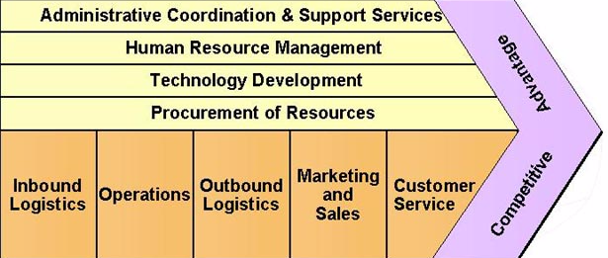
Value Chain (continued)
2
Support Processes
Primary
Business
Processes

Slide 15
Section II
2
Using Information Technology for Strategic Advantage

Slide 16
Strategic Uses Of Information Technology
2
Major competitive differentiator
Develop a focus on the customer
  Customer value
    Best value
    Understand customer preferences
    Track market trends
    Supply products, services, & information anytime, anywhere
    Tailored customer service

Slide 17
Strategic Uses of IT (continued)
2
Business Process Reengineering (BPR)
  Rethinking & redesign of business processes
  Combines innovation and process improvement
  There are risks involved.
  Success factors
    Organizational redesign
    Process teams and case managers
    Information technology

Slide 18
Strategic Uses of IT (continued)
2
Improve business quality
  Total Quality Management (TQM)
    Quality from customer’s perspective
    Meeting or exceeding customer expectations
    Commitment to:
      Higher quality
      Quicker response
      Greater flexibility
      Lower cost

Slide 19
2
Strategic Uses of IT (continued)
Becoming agile
  Four basic strategies
    Customers’ perception of product/service as solution to individual problem
    Cooperate with customers, suppliers, other companies (including competitors)
    Thrive on change and uncertainty
    Leverage impact of people and people’s knowledge

Slide 20
2
Strategic Uses of IT (continued)
The virtual company
  Uses IT to link people, assets, and ideas
  Forms virtual workgroups and alliances with business partners
  Interorganizational information systems

Slide 21
The Virtual Company (continued)
2
  Strategies
    Share infrastructure & risk with alliance partners
    Link complementary core competencies
    Reduce concept-to-cash time through sharing

Slide 22
2
The Virtual Company (continued)
  Strategies (continued)
    Increase facilities and market coverage
    Gain access to new markets and share market or customer loyalty
    Migrate from selling products to selling solutions

Slide 23
Learning Organizations
2
Exploit two kinds of knowledge
  Explicit
  Tacit

Slide 24
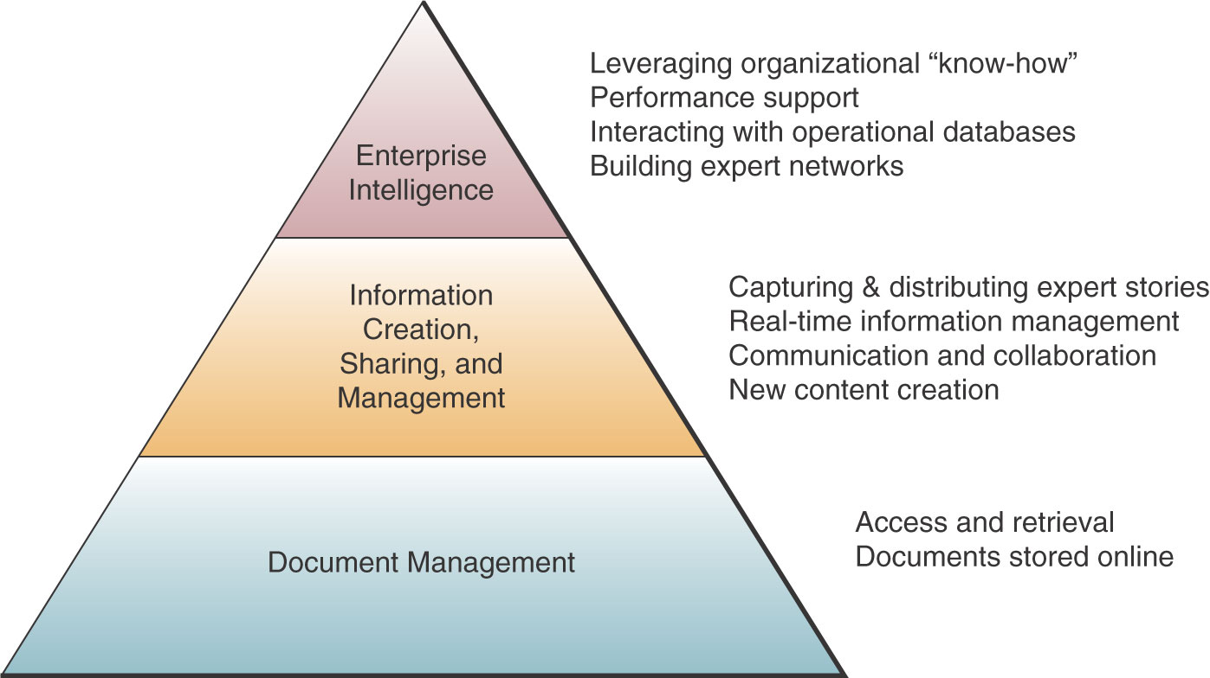
Learning Organizations (continued)
2

Slide 25
2
Learning Organizations (continued)
Knowledge management systems
  Help create, organize, and share business knowledge wherever and whenever needed within the organization

Slide 26
References
2
James A. O'Brien; George M. Marakas. Management Information Systems: Managing Information Technology in the Business Enterprise 6th Ed., Boston: McGraw-Hill/ Irwin,2004

Slide 27
References
2
James A. O'Brien; George M. Marakas. Management Information Systems: Managing Information Technology in the Business Enterprise 6th Ed. Boston: McGraw-Hill/ Irwin,2004

